Slide 1
PSP
Case study – A deep dive into a payment problem
By
Pravat Ranjan Pasayat

Slide 2
Agenda
Who am I?
Overview - Payment process
Problem statement
Root cause analysis
Proposed improvements
Opportunity for new potential customer
Impact analysis

Slide 3







Who am I?
Software Developer
(2012-2013)
Data Analytics Consultant
(2014-2018)
Master in Business Analytics & Big Data
(2018-2019)
Data Scientist
(2019-2020)
https://www.linkedin.com/in/pravat-pasayat-b6b846ab/

Slide 4

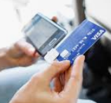



Overview – payment process (Taxi)
Submit payment order
Contact
Response
Response
Customer
On-board terminal
Payment Gateway
Response
Confirm payment
Payout
Merchant (Taxi company)
Issuing Bank

Slide 5


Problem statement
Customer
Payment Processes
Merchant
Payment initiation
Payment authorization
Payment clearing

Slide 6
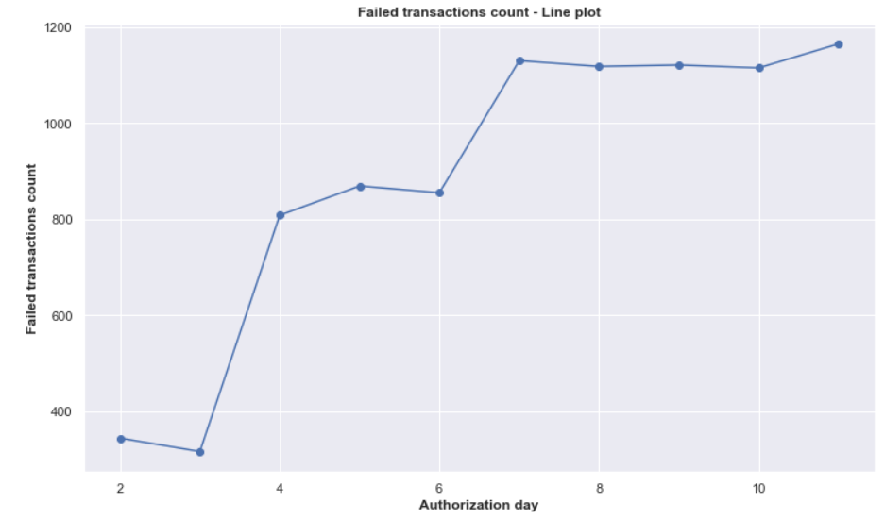
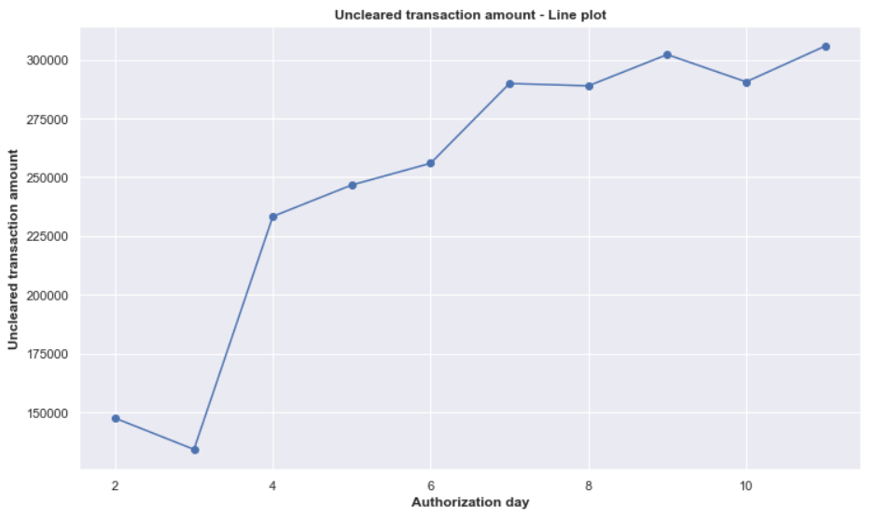

Impact analysis
9,000 out of 110,000 transactions (8.2%)
2,536,999 euros (11.6%)
Notes:
1. Feature engineering:
“Authorization day” from Authorization time
2. Plotting the graph:
Removal of data from incomplete days (start day ‘2019-01-01 13:44:02’ and end day ‘2019-01-12 03:32:10’)

Slide 7

RCA – clearing failure
Amount too high for card scheme
3DS not enrolled but used
Dual branding not possible for card product
1
2
3
Notes:
Check the unique values of ‘Error Code’

Slide 8
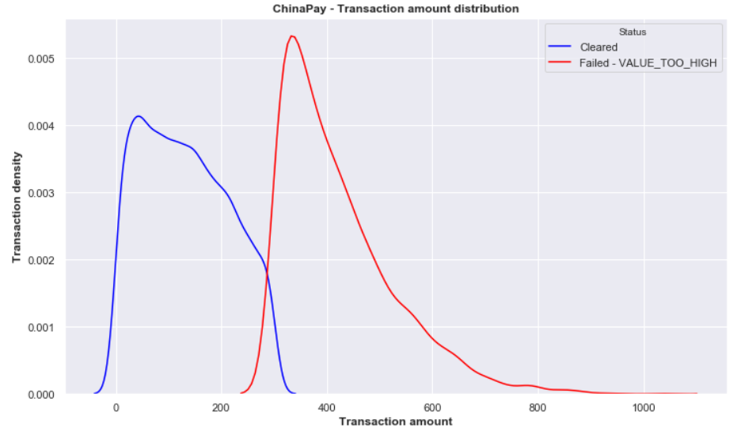
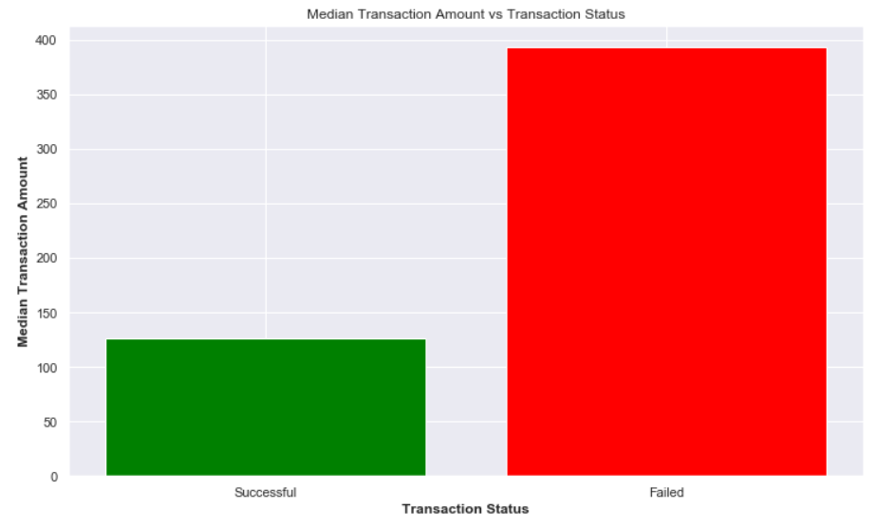
Error-1: amount too high for card scheme
Affected Card Scheme: ChinaPay (across all products i.e. Debit, Credit and QR)
Explanation: Concerned payment has an amount unexpectedly higher the usual amount.
Notes:
1. Transactions with ErrorCode1 grouped by ‘Processed Card Scheme’
Total number of Type-1 error = 3330
Total number of Type-1 error by ChinaPay = 3330
2. Double density plot of ChinaPay transactions (Successful and Failed)
Median transaction amount for successful transaction = 126.43 Euros
Median transaction amount for failed transaction = 393.4 Euros (211% increase)

Slide 9

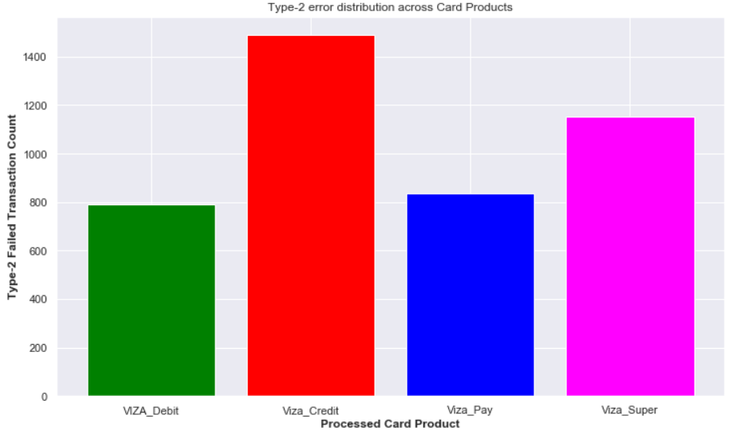
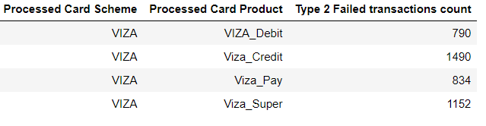
Error-2: 3DS not enrolled but used
Affected Card Scheme: VIZA (across all products i.e. Debit, Credit, Pay and Super)
Explanation: Concerned payment has been done from a card product that is not enrolled for 3DS but has used 3DS during payment processing.
Notes:
Use of BIN data to know which card products are enrolled for 3DS
BIN data joined to Transactional data
2. Transactions with ErrorCode2 grouped by ‘3DS enrolled’ and ‘3DS used’
Total number of Type-2 error = 4266
Total number of Type-2 error when 3DS is not enrolled but used = 4266
3. Transactions with ErrorCode2 grouped by ‘Card Scheme’ and ‘Card Product’
Total number of Type-2 error by VIZA = 4266

Slide 10

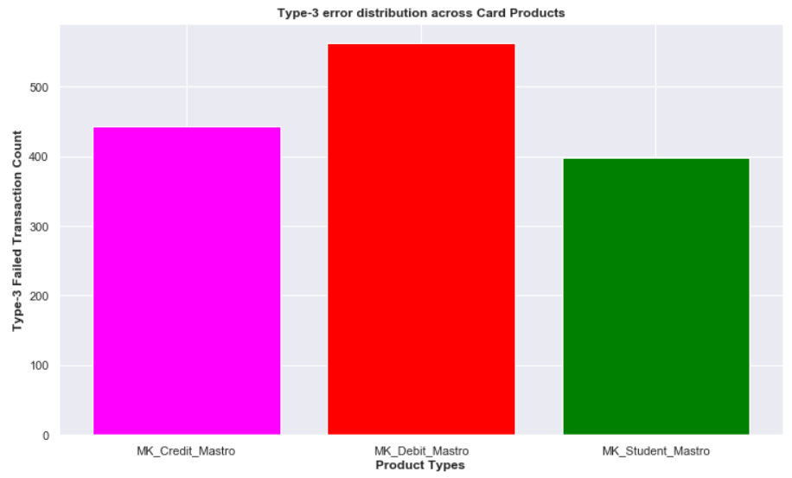
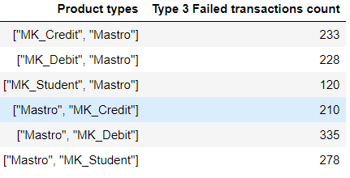


Error-3: dual branding not possible
Affected Card Scheme: Masterkard (only for product ‘Mastro’)
Explanation: Concerned payment has been done from Masterkard-Mastro product with dual branding (on MK Debit, Credit and Student) and with active 3DS enrollment.
Notes:
Use of BIN data to know which card products have Dual Branding
BIN data joined to Transactional data
2. Transactions with ErrorCode3 grouped by ‘Dual branded’
Total number of Type-3 error = 1404
Total number of Type-3 error when Dual branded = 1404
3. Transactions with ErrorCode3 grouped by ‘Card Scheme’ and ‘Card Product’
Total number of Type-3 error by Masterkard (Mastro) = 1404
4. Transactions with ErrorCode3 grouped by ‘3DS enrolled’
Total number of Type-3 error by 3DS is enrolled = 1404
Total number of Type-3 error by Masterkard Mastro product = 1404
Total number of Type-3 error when 3DS is not enrolled = 1404

Slide 11

Process improvement ideas
Process latency
The clearing and settlement process takes more time (from few hours up to 28 days)
High processing fees
High payment processing fees that includes a share for issuing bank, a share for card scheme and a share for PISP.
Payment failure
In case of a failure during payment processing (e.g. Authorization successful, but clearing failure), payment towards merchants takes significant more time. There might be some monetary loss for PSP

Slide 12
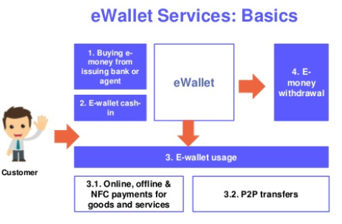
PSP e-wallet
PSP e-wallet is a digital payment instrument and a payment method where
Step-1: The user transfers money from his/her bank account or credit card to e-wallet
Step-2: Then use the money from the e-wallet while doing payments to merchants.
What’s there for merchants?
Real-time clearing and settlement process (Concern-1)
Less commission for payment processing (Concern-2)
What’s there for users?
Added incentives (e.g. discounts) while using e-wallet
What’s there for PSP?
New revenue component - e-wallet payment method
Notes:
NFC: Near field communication (contactless)

Slide 13

Predictive payment failure detection
Several times payment processing fails during the clearing process, leading to delay in payout to merchants and sometimes monetary losses to PSP.
Problem and impact get bigger when we don’t detect this early and act on it soon.
Question here is
Can we predict the outcome of the clearing process while doing payment authorization?
How?
Applying machine learning on historical payment data to predict incoming payment’s clearing status. (Concen-3)

Slide 14
Revenue estimate
PSP e-wallet: (pilot version in EU)
Number of payments using e-wallet per month (A) = 2 million
Average shopping amount (B) = 100 euros
Commission or processing fee rate from payment method (C) = 0.7%
Incentive towards user promotion (D) = 0.2%
Net revenue (yearly) = A * B * (C - D)/100 * 12 =
Predictive payment failure detection:
Total processed amount by PSP in 2018 (A) = 160 billion
Percentage of processed money unaccounted due to clearing failure (B) = 1%
Percentage of unaccounted money turned out as loss to PSP (C) = 1%
Percentage of loss that is mitigated by this predictive approach (D) = 50%
Net revenue (yearly) = A * (B/100) * (C/100) * (D/100) =
6 million euros
8 million euros

Slide 15
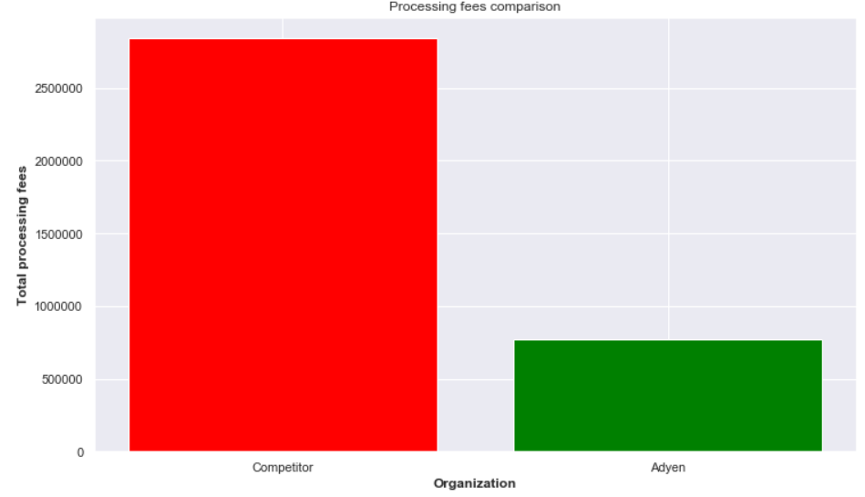
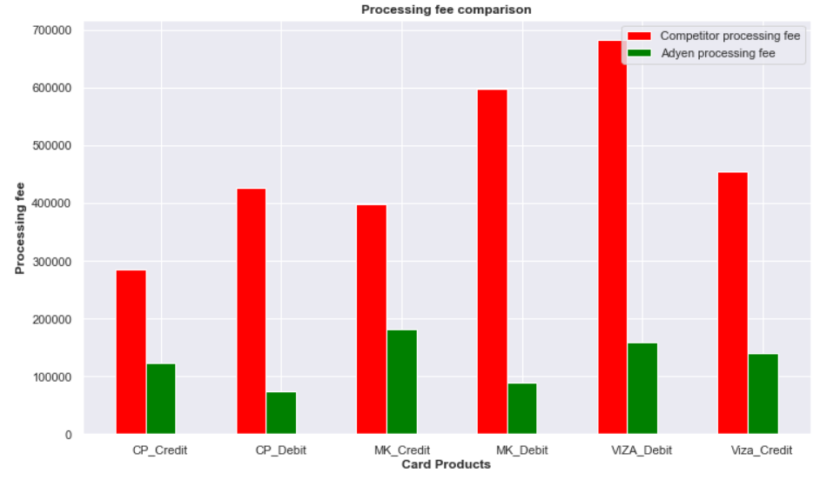
Opportunities for taxily
Competitor - Flat 3% processing fee rate across all type of payment methods
vs
PSP - Custom processing fee rate per card scheme and even per card product
Notes:
Use of Rates data
Scope is only Msterkard, Chinapay and VIZA schemes; Allowed card products are Debit and Credit card
Average rate per card product
CP_Credit 1.2981111
CP_Debit 0.5220292
MK_Credit 1.3646863
MK_Debit 0.4512724
VIZA_Debit 0.6990705
Viza_Credit 0.928691
4. Calculation:
Competitor: 2845311.69 euros processing fees last month (Rate 3%)
PSP: 768524.35 euros processing fees last month. (Rate variable per card product)
Saving of around 2076787.34 euros.
Reduction in the processing fees by 73%.
Reduction across card products i.e. ChinaPay Credit (56.7%), ChinaPay Debit (82.6%), Masterkard Credit (54.5%), Masterkard Debit (85.0%), Vizza Credit (69.0%) and Vizza Debit (76.7%) cards.

Slide 16
Thanks for your attention
Questions?
Pasayat.pravat@gmail.com

